Slide 1
Planning in the Continuous Domain: a Generalized
Belief Space Approach for Autonomous Navigation in
Unknown Environments
Vadim Indelman, Luca Carlone , and Frank Dellaert
International Journal of Robotics Research - 2015
Dan and Alon

Slide 2
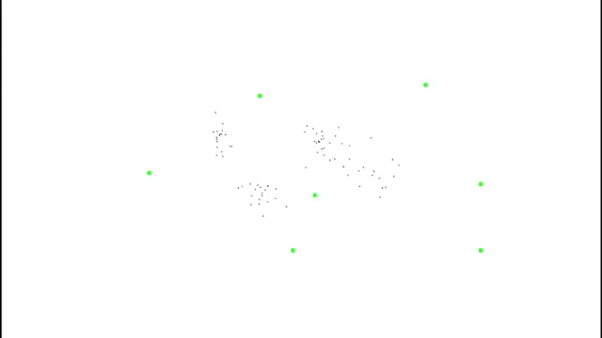
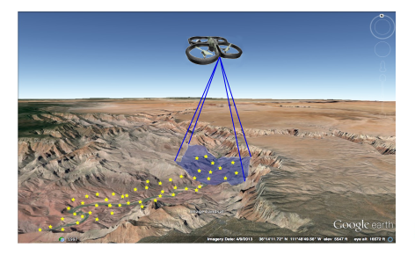

Slide 3
Mission
Reach goals without exceeding uncertainty level
Assumptions
Unknown Environments
Maximum Likelihood observations

Slide 4
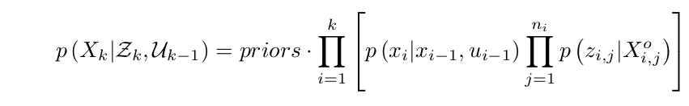
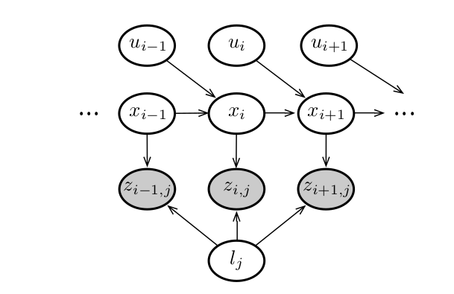
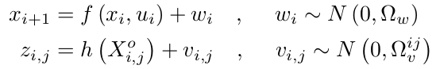

Slide 5
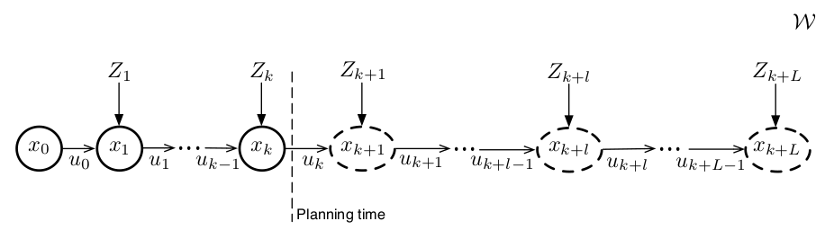
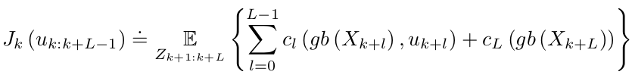
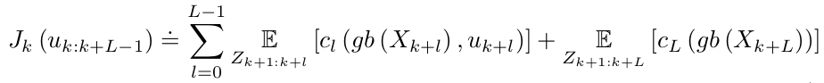

Slide 6
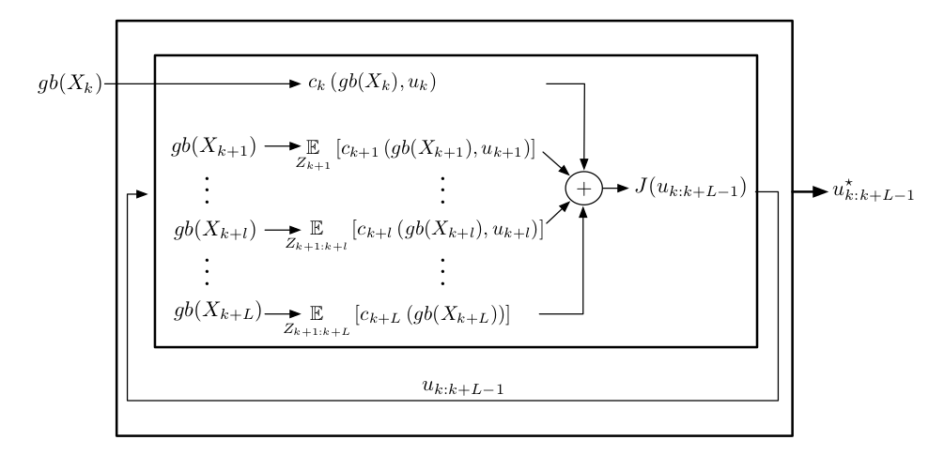
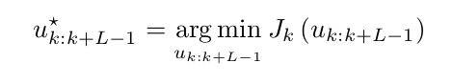
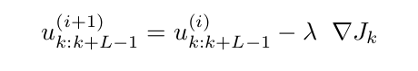

Slide 7
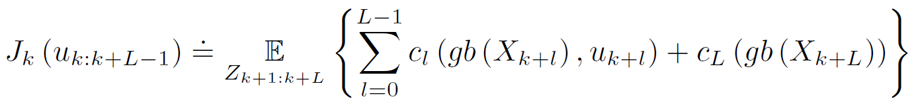
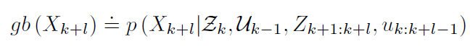
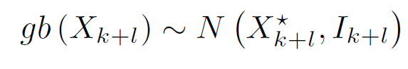

Planning in the GBS
At planning time $t_{k}$, the optimal control minimizes an objective
$J_{k}(u_{k:k+L−1}$) for $L$ look ahead steps:
reminder:
The objective involves $L$immediate cost functions $c_{l}$, one for each look-ahead step.
The subscript $k$ in $J_{k}$ to remark that the objective function depends on the generalized belief $gb(x_{k})$ at planning time $t_{k}.$

Slide 8
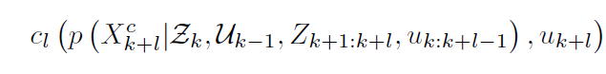

Planning in the GBS
We can see in the objective that the expectation is taken to account for all the possible observations during the planning lag. Since these are not given at planning time and are stochastic, each immediate cost function $c_{l}$ may involve ant subset of states $X_{k+l}^{c}⊆X_{k+l }.$
Therefore, the immediate cost $c_{l}$ can be written as:

Slide 9

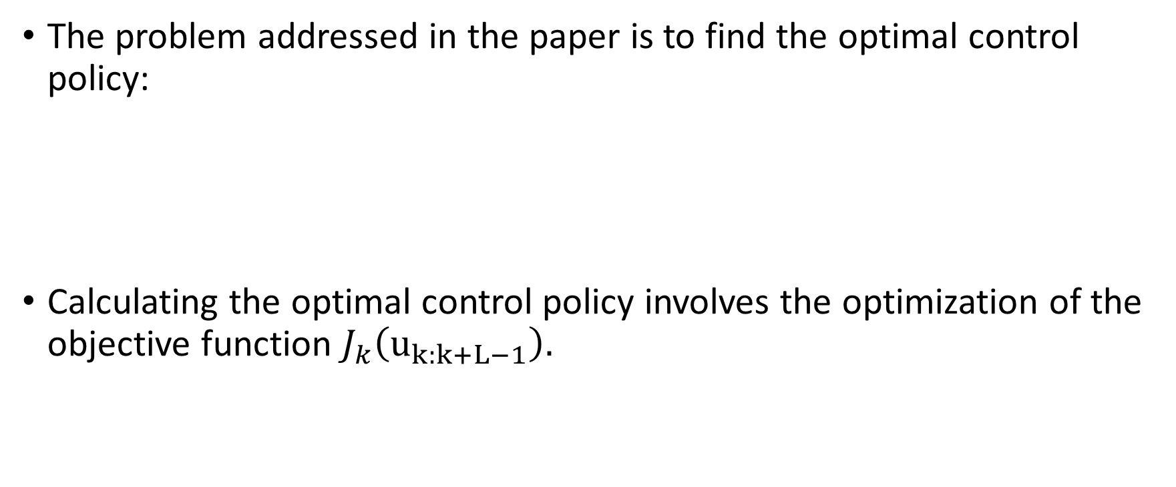
Planning in the GBS
The problem addressed in the paper is to find the optimal control policy:
Calculating the optimal control policy involves the optimization of the objective function $J_{k}\left(u_{k:k+L−1}\right).$

Slide 10

Planning in the GBS
The expectation is a linear operator so we can rewrite the objective function as:
In order to optimize the objective function ,as written in the paper, we resort to an iterative optimization approach, starting from known initial guess on the controls.

Slide 11
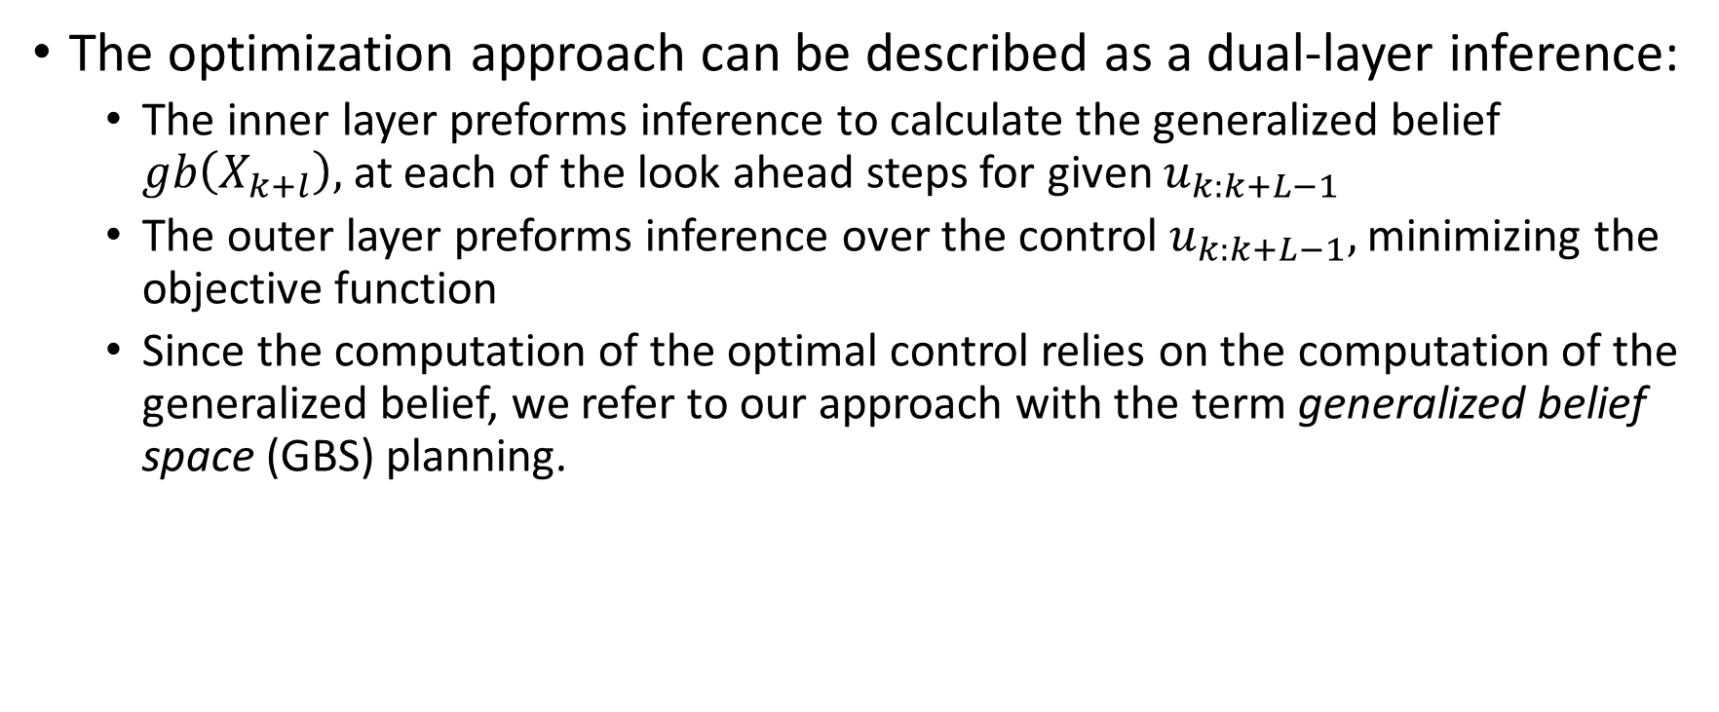
Planning in the GBS
The optimization approach can be described as a dual-layer inference:
The inner layer preforms inference to calculate the generalized belief $gb\left(X_{k+l}\right),$at each of the look ahead steps for given $u_{k:k+L−1}$
The outer layer preforms inference over the control $u_{k:k+L−1},$ minimizing the objective function
Since the computation of the optimal control relies on the computation of the generalized belief, we refer to our approach with the term generalized belief space (GBS) planning.

Slide 12
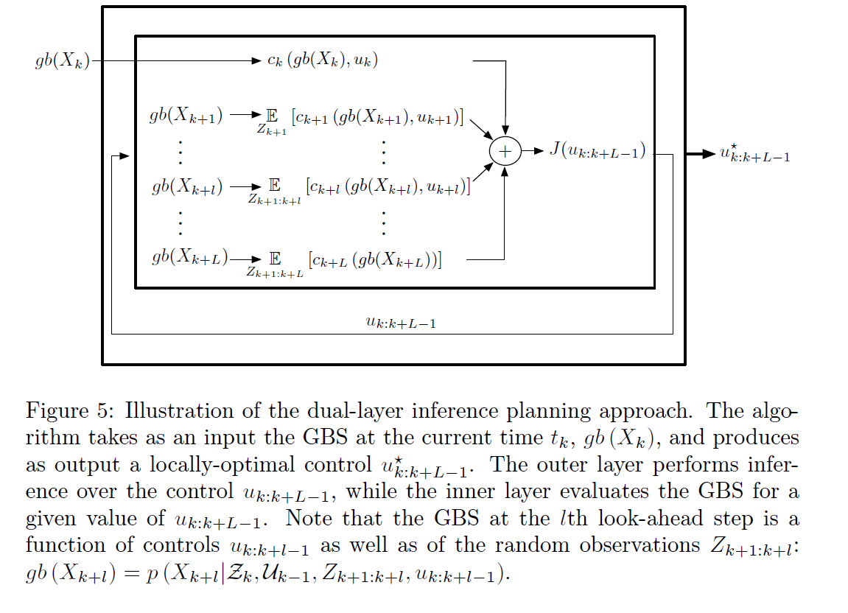
Planning in the GBS
Illustration of the dual-layer inference planning approach:

Slide 13
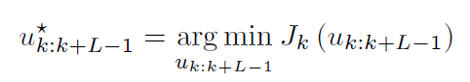
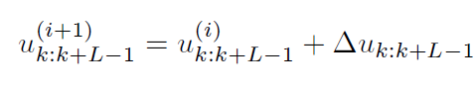
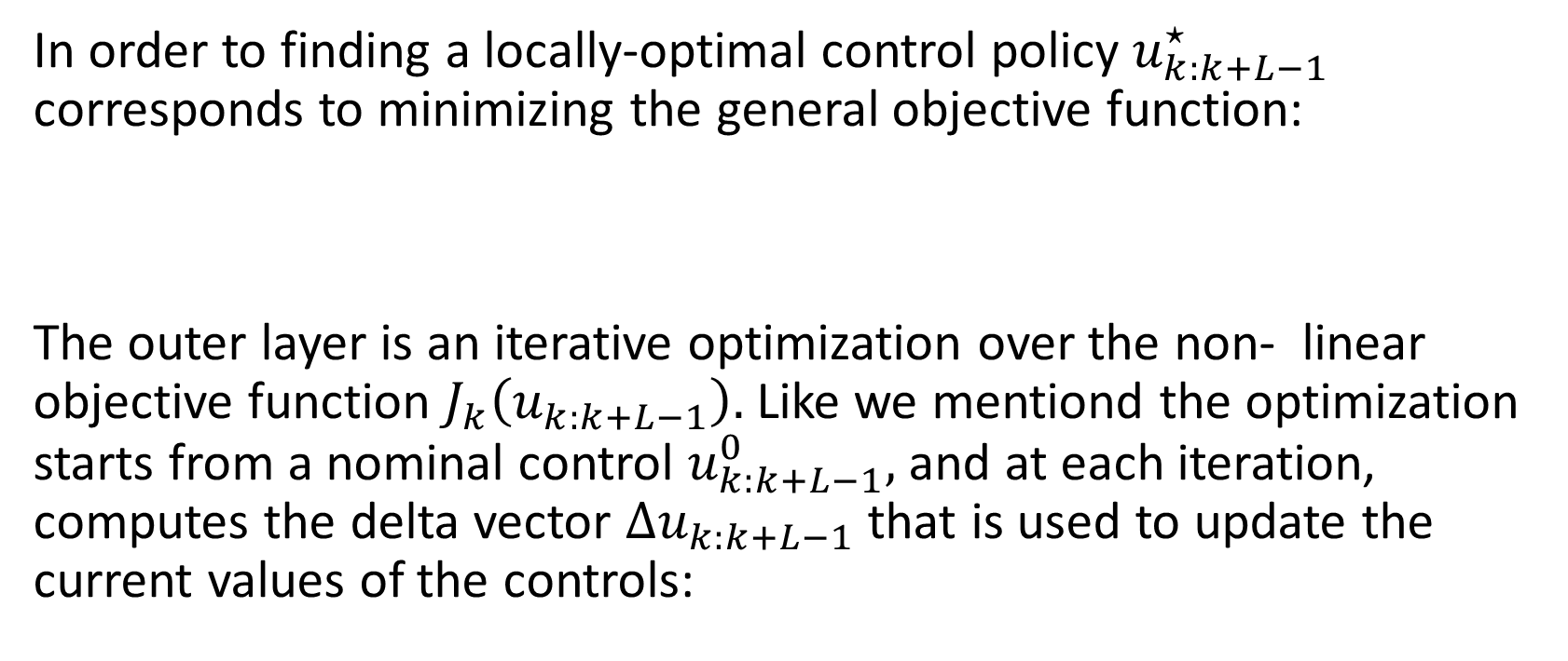
Planning in the GBS
Outer Layer: Inference over the control
In order to finding a locally-optimal control policy $u_{k:k+L−1}^{⋆}$ corresponds to minimizing the general objective function:
The outer layer is an iterative optimization over the non- linear objective function $J_{k}\left(u_{k:k+L−1}\right).$ Like we mentiond the optimization starts from a nominal control $u_{k:k+L−1}^{0},$ and at each iteration, computes the delta vector $Δu_{k:k+L−1}$ that is used to update the current values of the controls:

Slide 14
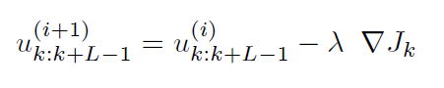
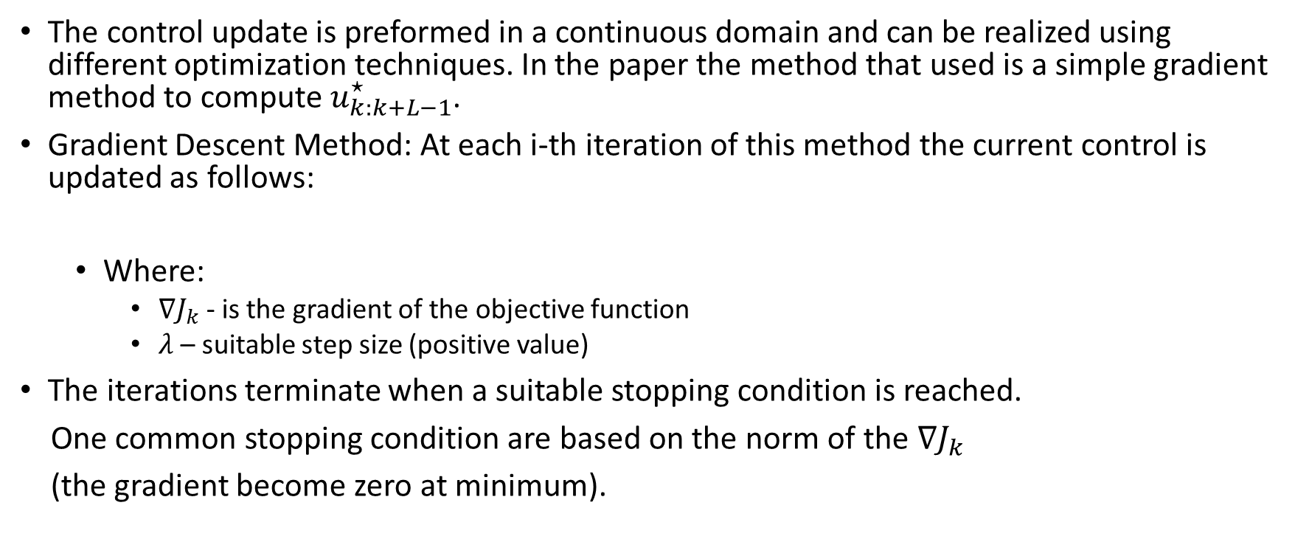
Outer Layer: Inference over the control
Planning in the GBS
The control update is preformed in a continuous domain and can be realized using different optimization techniques. In the paper the method that used is a simple gradient method to compute $u_{k:k+L−1}^{⋆}$.
Gradient Descent Method: At each i-th iteration of this method the current control is updated as follows:
Where:
$∇J_{k}$- is the gradient of the objective function
$λ$– suitable step size (positive value)
The iterations terminate when a suitable stopping condition is reached.
One common stopping condition are based on the norm of the $∇J_{k}$
(the gradient become zero at minimum).

Slide 15

Outer Layer: Inference over the control
Planning in the GBS
upon convergence the gradient method provides the optimal control policy $u_{k:k+L−1}^{⋆}$ for $L$ look-ahead steps.
according to the standard model predictive control framework at each time the agent solve the optimization problem and only applies the first command $u_{k}^{⋆}$ extracted from the computed policy $u_{k:k+L−1}^{⋆}$

Slide 16
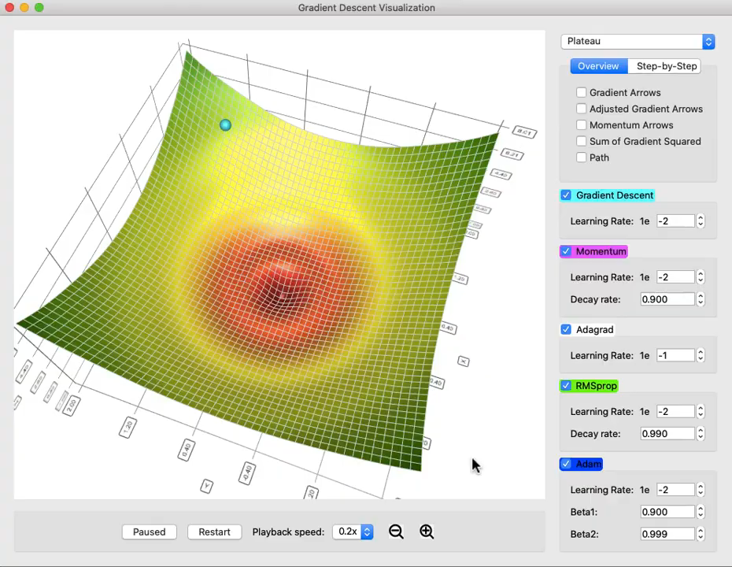
Outer Layer: Inference over the control
Planning in the GBS
Gradient descent simulation

Slide 17
Inner Layer: Inference in GBS
Planning in the GBS

Slide 18
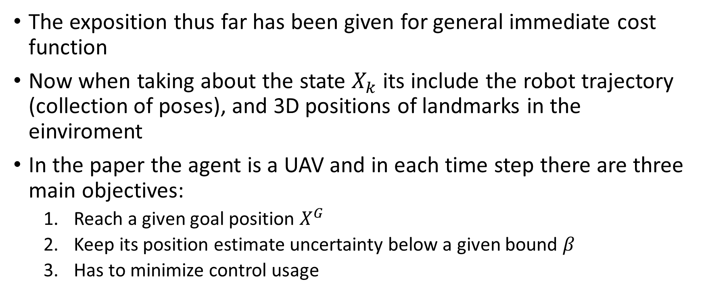
Objective functions
The exposition thus far has been given for general immediate cost function
Now when taking about the state $X_{k}$ its include the robot trajectory (collection of poses), and 3D positions of landmarks in the einviroment
In the paper the agent is a UAV and in each time step there are three main objectives:
Reach a given goal position $X^{G}$
Keep its position estimate uncertainty below a given bound $β$
Has to minimize control usage

Slide 19
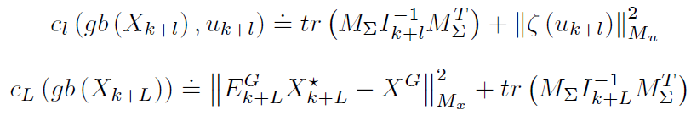
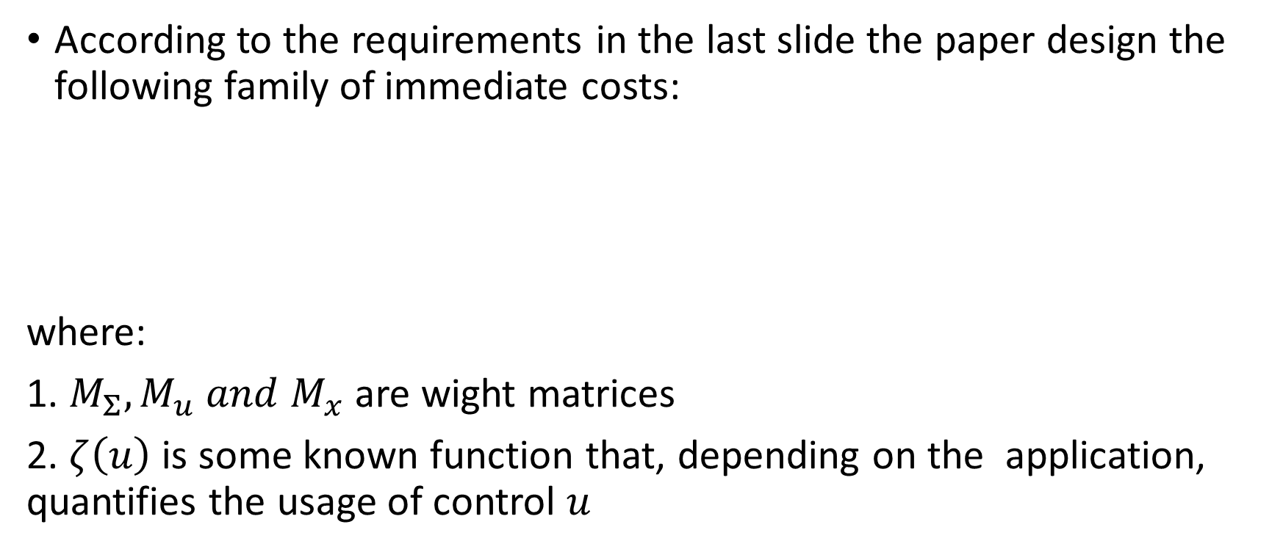
Objective functions
According to the requirements in the last slide the paper design the following family of immediate costs:
where:
1. $M_{Σ},M_{u} and M_{x}$ are wight matrices
2. $ζ\left(u\right)$ is some known function that, depending on the application, quantifies the usage of control $u$

Slide 20
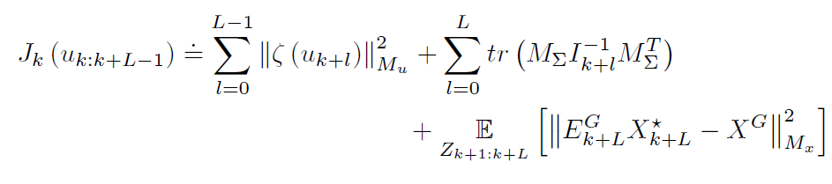

Objective functions
Reminder that our general objective function form is:
Plugging the 2 equations from the previews slide into the objective form we get:
Denote that the expectation removed from the first and the second summand as they do not depend on $Z_{k+1:k+L}.$

Slide 21
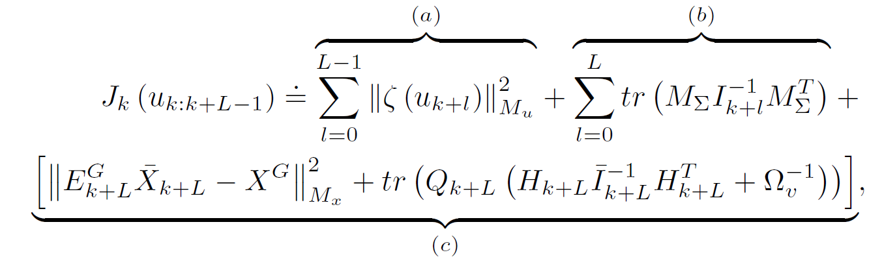
Objective functions
After computing the expectation in the last summand in the objective function in the previews slide, the objective function get the form:
Where the term (a) contains term penalizing control usage; the term (b) contains terms penalizing uncertainty, and the term (c) represents the expected inventive in reaching the goal.

Slide 22
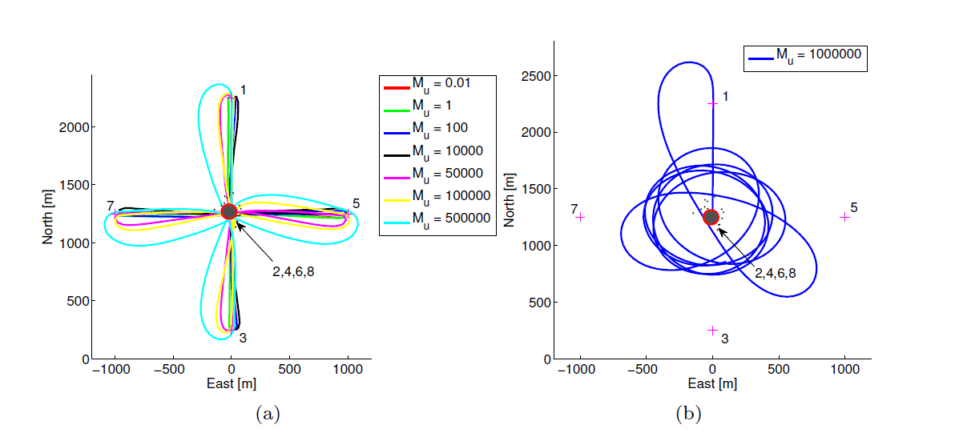

Objective functions
Implementation Details
In the final objective term, we saw that we have three weight matrices $M_{Σ},M_{u} and M_{x},$ and now we will discuss how to properly choose them.
Choice of $M_{u}:$This matrix has a very intuitive function. A large $M_{u}$ induces more conservative policies that penalize large controls. In the paper scenario, the control usage $ζ(u)$ quantifies the change in the yaw angle;, which is used by the UAV to control the direction of its motion. In the demonstrated Figure, from the paper below, we can see that higher values of $M_{u}$ lead to smoother movement (apply smaller force to change the yaw angle). In the figure the goal is to move from the red point to each of the points 1,3,5,7 and then go back to the start position.

